Slide 1

Malicious Software

Slide 2





Content
Introduction
Types of Malicious Software
worm
Spams
Email trojan horse
Spyware
Propagation
Type of propagation
Payload
Conclusion

Slide 3

Malicious Software
Malicious Software, Commonly Known As Malware, Refers To Any Software Specifically Designed To Harm, Exploit, Or Otherwise Compromise Computer Systems, Networks, Or Devices.

Slide 4
Types of Malicious Software
Worms
Spams
Email trojan horse
Spyware
Propagation
Payload

Slide 5
Worms
Worms are A type of malicious software that replicate themselves to spread across networks without requiring user interaction.
Eg:-
Mydoom (2004)
Conficker (2008)
Iloveyou (2000)
Sasser (2004)
Blaster (2003)

Slide 6
Spams
Spam refers to unsolicited and often irrelevant messages sent in bulk, primarily via email.
Eg:-
Promotional emails
Phishing emails
Nigerian prince scams
Fake lottery wins
Malicious links

Slide 7
Email trojan horse
Email trojans are a type of malicious software delivered through email attachments or links.
Eg:-
Emotet
Dridex
Zloader
Qakbot

Slide 8
Spyware
Spyware is a type of malicious software designed to secretly monitor and collect information about a user's activities without their consent.
Eg:-
Keyloggers
Commercial spyware
Adware with spyware features
Remote access trojans (rats)
Financial spyware

Slide 9
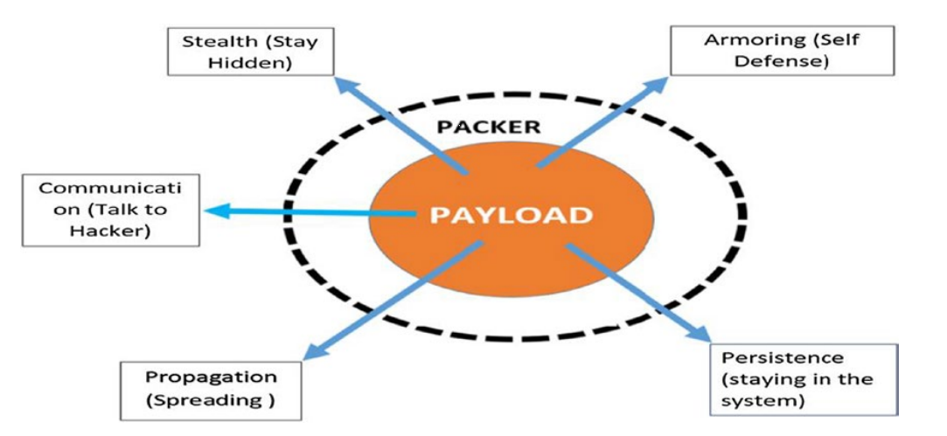
Propagation
Propagation refers to the methods used by malware to spread and infect other systems or devices. Understanding propagation is crucial for cybersecurity, as it helps identify how threats can multiply and evade detection.

Slide 10
Type of propagation
Network based propagation (Eg:- remote code execution, worms)
File-based propagation (Eg:- trojans , viruses)
Email &Phishing-based propagation (Eg:- phishing attacks, spyware)
Removable media propagation (Eg:- autorun worms, USB based viruses)
Social Engineering-based propagation (Eg:- phishing, social media link)
Drive - by Download propagation (Eg:- adware, spyware)
Botnet-Based propagation (Eg:- DDOS attacks, remote access trojans)
Application and software supply propagation (Eg:- supply chain attackers, software backdoors)

Slide 11
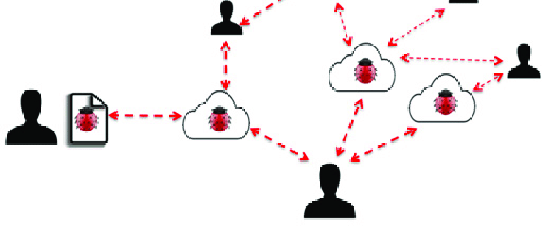
Payload
Payload is a part of malware designed to carry out its main purposes once it has successfully infiltrated a target system. Unlike the propagation method which is how malware spreads, the payload represents the harmful action , such as stealing data, encryption files, launching denial of service attacks, or allowing unauthorized access.

Slide 12
Conclusion
Malware poses a significant threat to cybersecurity. It spreads through various propagation methods and often delivers harmful payloads, impacting individuals , organization and entire networks. As malware continues to evolve, staying informed and implementing strong cybersecurity practices such as regular software updates, user education , and productive threat detection are crucial in reducing vulnerabilities and mitigating risks.

Slide 13
Thank You !

